Slide 1

MACHINE LEARNING
24Ad2204
Algorithm
Experment-2

Slide 2
Experiment # 2: IMPLEMENT K-FOLD CROSS-VALIDATION AND BOOTSTRAP SAMPLING
Algorithm
Relates to CO1 Concepts
Preparing to model: K-Fold Cross-validation ensures our evaluation is robust despite data quality issues.

Slide 3
Pre-Lab Concepts & Questions
What is the purpose of k-Fold Cross-Validation?
A Instead of splitting your data into just one training set and one test set, you split it into k equal parts (folds).
You then train the model k times, each time using a different fold as the test set and the remaining folds as the training set.
You average the results from all k tests.
It uses all data for both training and testing (just not at the same time), giving a more reliable and stable performance estimate than a single random train/test split.

Slide 4
Pre-Lab Concepts & Questions
How does Bootstrap sampling work?
Bootstrap sampling is a straightforward resampling technique used to estimate statistics (like the mean or median) of a population when you only have one sample.
What is the bias-variance tradeoff in model evaluation?
The bias-variance tradeoff is a key concept about the balance a model must strike between two types of errors:
Bias: Error from overly simplistic assumptions. High bias means the model misses important patterns (underfitting).
Variance: Error from being too sensitive to training data. High variance means the model learns noise and performs poorly on new data (overfitting).
Tradeoff: You can't minimize both at the same time. As you make a model more complex to reduce bias, its variance tends to increase, and vice-versa.
Simple Model: High Bias, Low Variance (Consistently wrong)
Complex Model: Low Bias, High Variance (Inconsistent—good on training data, bad on new data)
The goal is to find the sweet spot where total error is minimized, creating a model that generalizes well to unseen data.

Slide 5
Pre-Lab Concepts & Questions
Write Python code to split data into k folds.
model. from sklearn.model_selection import KFold
import numpy as np
# Create example data
data = np.arange(100)
X = data # Features
y = data * 2 # Target (example)
# Create KFold object
kf = KFold(n_splits=5, shuffle=True, random_state=42)
# Split data
folds = []
for train_index, test_index in kf.split(X):
X_train, X_test = X[train_index], X[test_index]
y_train, y_test = y[train_index], y[test_index]
folds.append((X_train, X_test, y_train, y_test))
print(f"Train: {len(train_index)}, Test: {len(test_index)}")
How do you calculate confidence intervals using Bootstrap?
Resample with replacement from your original data many times (e.g., 1000–10,000 times), each sample the same size as the original.
Compute your statistic (mean, median, proportion, etc.) for each resample.
Use the distribution of these bootstrap statistics to get the confidence interval.

Slide 6
In-Lab Program Explanation
Write a Python program to:
Load a dataset (e.g., Iris).
Implement k-Fold Cross-Validation for k-NN classifier.
Calculate and print average accuracy across folds.
Implement Bootstrap sampling for linear regression parameters.
Plot confidence intervals for regression coefficients.

Slide 7
In-Lab Program Explanation
import numpy as np
import matplotlib.pyplot as plt
from sklearn.datasets import load_iris
from sklearn.neighbors import KNeighborsClassifier
from sklearn.linear_model import LinearRegression
from sklearn.metrics import accuracy_score
# Load dataset
iris = load_iris()
X, y = iris.data, iris.target
# 1. k-Fold Cross-Validation for k-NN
def k_fold_cv(X, y, k=5, n_neighbors=3):
fold_size = len(X) // k
accuracies = []
for i in range(k):
start, end = i * fold_size, (i + 1) * fold_size
X_test, y_test = X[start:end], y[start:end]
X_train = np.vstack([X[:start], X[end:]])
y_train = np.hstack([y[:start], y[end:]])
knn = KNeighborsClassifier(n_neighbors=n_neighbors)
knn.fit(X_train, y_train)
y_pred = knn.predict(X_test)
accuracies.append(accuracy_score(y_test, y_pred))
return np.mean(accuracies)

Slide 8
In-Lab Program Explanation
# Run k-Fold CV
avg_accuracy = k_fold_cv(X, y, k=5)
print(f"Average k-NN accuracy (k-Fold CV): {avg_accuracy:.3f}")
# 2. Bootstrap for Linear Regression
def bootstrap_regression(X, y, n_bootstraps=1000):
n_samples = len(X)
coefs = []
for _ in range(n_bootstraps):
indices = np.random.choice(n_samples, n_samples, replace=True)
X_boot = X[indices]
y_boot = y[indices]
model = LinearRegression()
model.fit(X_boot, y_boot)
coefs.append(model.coef_)
return np.array(coefs)
# Prepare data for regression (using first two features)
X_reg = X[:, :2]
y_reg = X[:, 2] # Predict third feature from first two
# Run bootstrap
coefs = bootstrap_regression(X_reg, y_reg, n_bootstraps=500)

Slide 9
In-Lab Program Explanation
# 3. Plot confidence intervals
plt.figure(figsize=(10, 4))
plt.subplot(1, 2, 1)
plt.hist(coefs[:, 0], bins=30, alpha=0.7, edgecolor='black')
plt.axvline(np.percentile(coefs[:, 0], 2.5), color='red', linestyle='--')
plt.axvline(np.percentile(coefs[:, 0], 97.5), color='red', linestyle='--')
plt.title('Coefficient 1 (95% CI)')
plt.xlabel('Value')
plt.subplot(1, 2, 2)
plt.hist(coefs[:, 1], bins=30, alpha=0.7, edgecolor='black')
plt.axvline(np.percentile(coefs[:, 1], 2.5), color='red', linestyle='--')
plt.axvline(np.percentile(coefs[:, 1], 97.5), color='red', linestyle='--')
plt.title('Coefficient 2 (95% CI)')
plt.xlabel('Value')
plt.tight_layout()
plt.show()
# Print summary
print(f"\nBootstrap results (95% confidence intervals):")
for i in range(coefs.shape[1]):
lower = np.percentile(coefs[:, i], 2.5)
upper = np.percentile(coefs[:, i], 97.5)
print(f"Coefficient {i+1}: [{lower:.3f}, {upper:.3f}]")

Slide 10
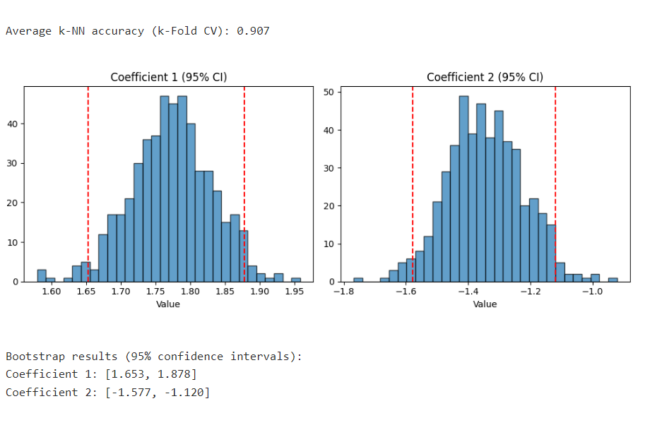
Output

Slide 11
Sample Viva Questions
Difference between k-Fold and Leave-One-Out Cross-Validation.
Why use Bootstrap for parameter stability?
How does k affect cross-validation results?
What are confidence intervals in Bootstrap?
When would you prefer Bootstrap over cross-validation?

Slide 12
Post-Lab Program
Extend your program to:
Compare k-Fold results with train-test split.
Implement stratified k-Fold for imbalanced data.
Calculate Bootstrap standard error for regression parameters.
Visualize Bootstrap distribution of parameters.
Write a function to automate k-Fold for any classifier

Slide 13
THANK YOU

